Slide 1


ETL (Extract – Transform -Load)
Presented by:
AYMANE MAGHOUTI (Data Engineering Student (ID2))

Slide 2
Outline:
Implement your ETL process
Native Method
Using ETL Tools
Process Type
ETL vs ELT
Demo (Mini project)
Context (Problem)
Objectif
ETL Pipeline
ETL steps

Slide 3
Context (Problem)
entreprise de vente a plusieurs source et il veut prendre des décision alors comment se faire ?
Data(API,CSV,JSON,Data Base transactionnel) -------------------- Base analytique orientée métier (Data warehouse)
Solution ETL …..!

Slide 4
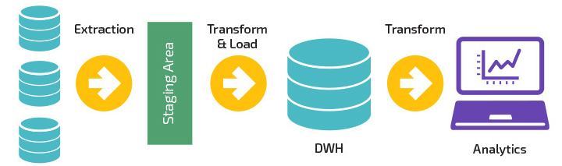
Objectif
Powering data warehouses
Data integration

Slide 5
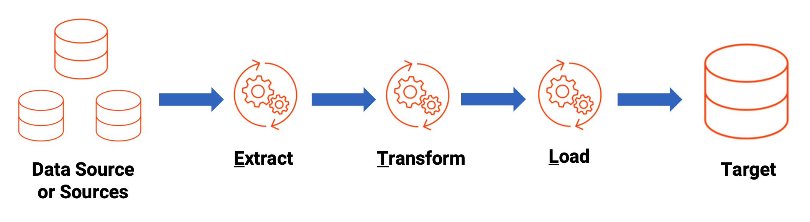
ETL Pipeline

Slide 6
ETL steps

Slide 7
Step 1 : Extraction
Data Source :
Relational database (MySQL, ORACLE, PostgreSQL, etc.)
Non-relational database (MongoDB…)
WEB API (Youtube API)
Web application (using scrapping instead of api)
JSON, CSV, XML….
Social media (FB, Instagram, ...)

Slide 8
Extraction Type:
Full Extraction: extracting all the data from the source system each time the ETL process runs.
Incremental Extraction: retrieving only the data that has been added or modified since the last extraction.
Partition Extraction: dividing the dataset into smaller partitions or subsets based on certain criteria.

Slide 9
Step 2 : Transform
Data cleaning : removing duplicates, null_values…
Data enrichment: adding additional information to the data
Data Transformation: converting the data into a format that is suitable for loading into the target system.
Data validation: ensure that the data being used is reliable and trustworthy.

Slide 10
Step 3 : Loading
Full Load : Loading all the data from the source into the target system each time, replacing existing data entirely.
Incremental Load : Loading only the new or changed data since the last load, minimizing processing time and resource usage.
Delta Load : Loading only the changes (or "delta") between the source and target systems since the last load, typically used for real-time or near-real-time data synchronization.

Slide 11
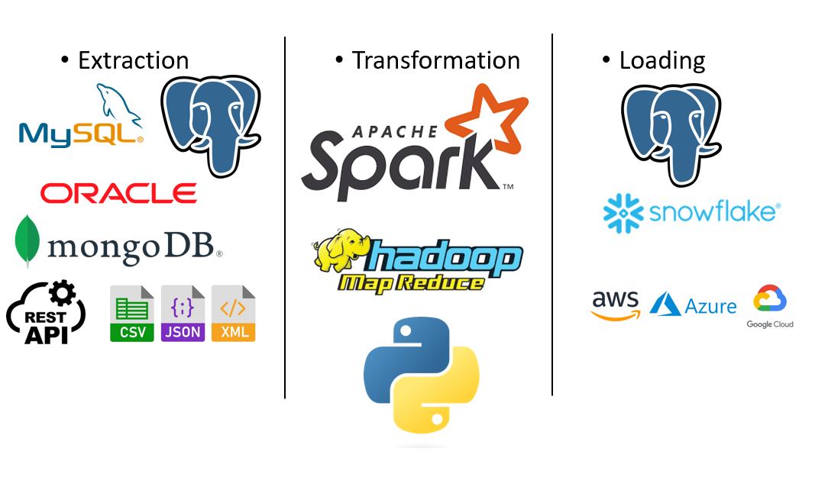

Slide 12
Implement your ETL process
Define the source
Choose the data to extract
Plan the transformation
Choose the target

Slide 13
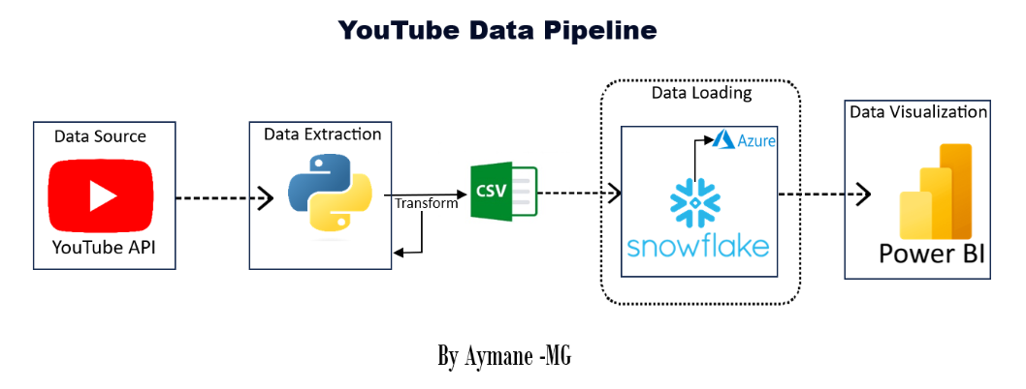
Native Method
Using programming languages (ex. Python)
Example:

Slide 14
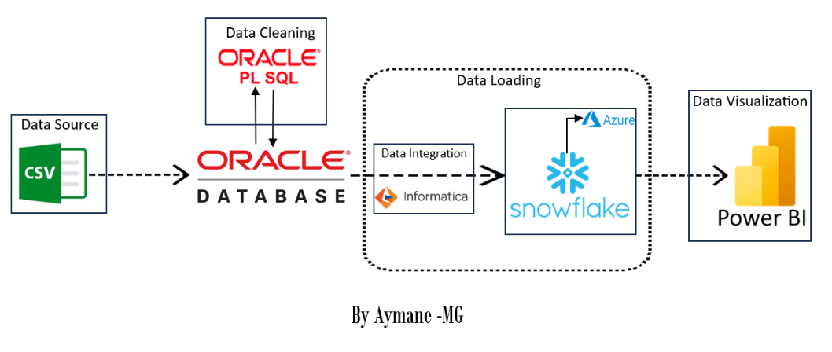
Using ETL Tools
Informatica
Talend
SSIS
Example

Slide 15
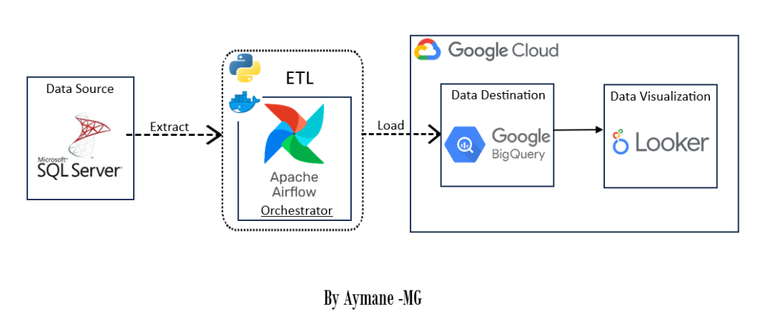
Orchestration
Example:

Slide 16
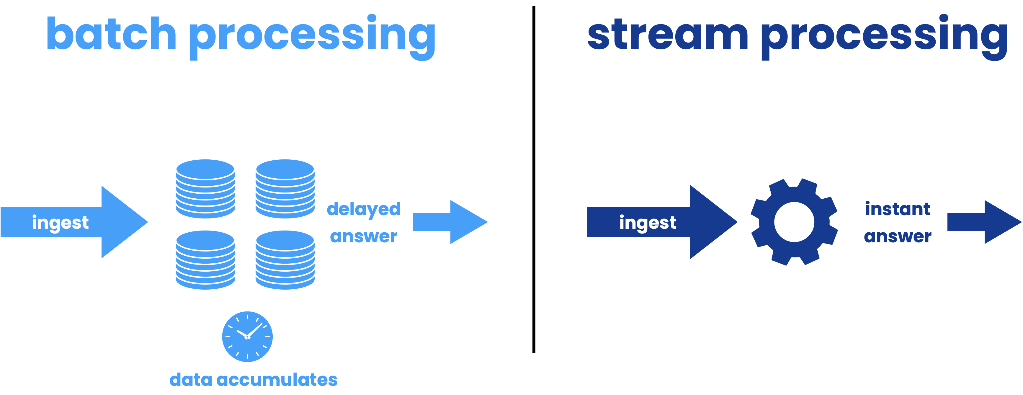
Process Type

Slide 17
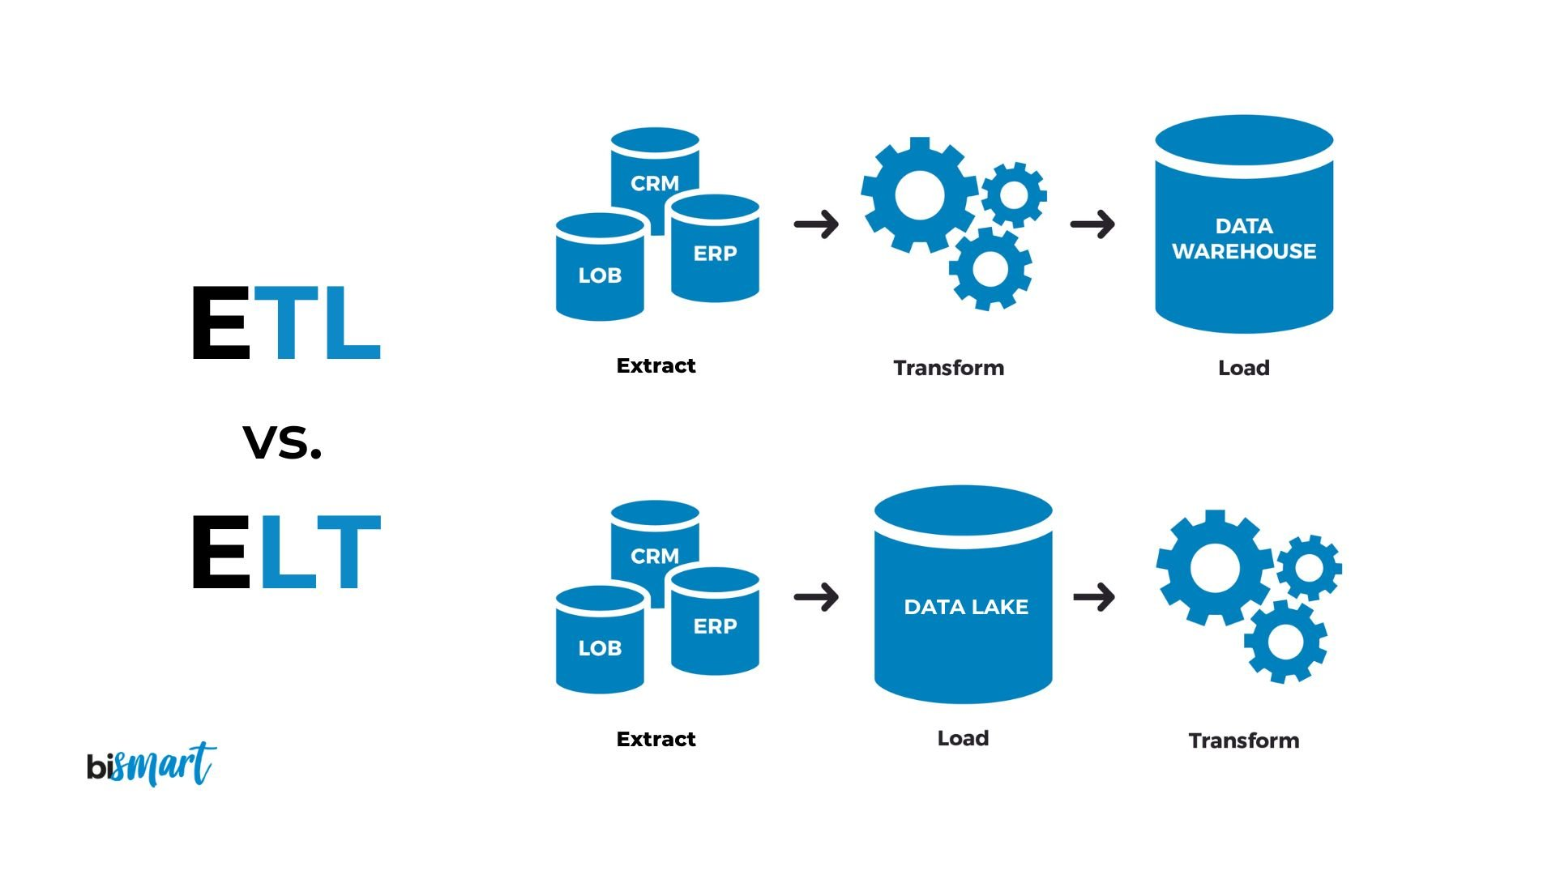
ETL vs ELT

Slide 18
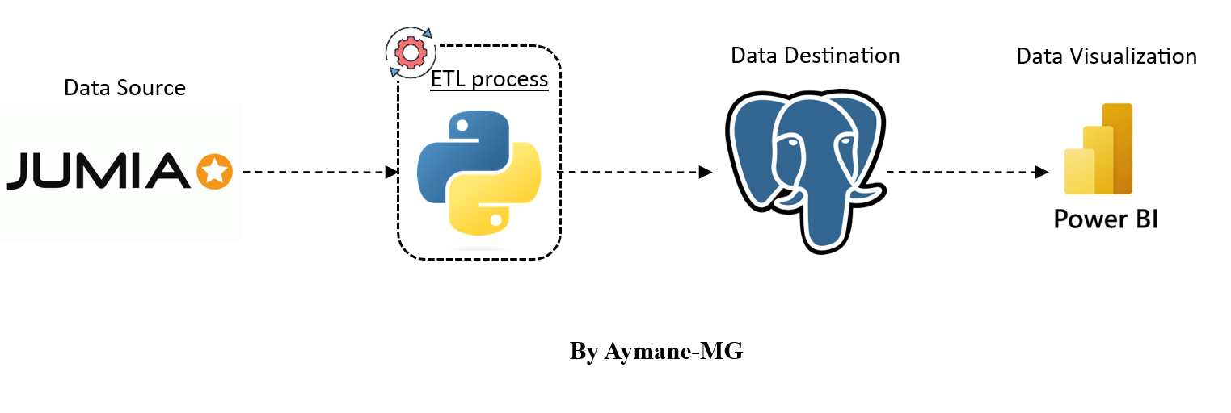
Demo (Mini project)

Slide 19
Thank you for your attention !

